Slide 1
REGIONAL TRAINING COURSE ON METHODS AND TOOLS TO IDENTIFY SOURCES OF AIR POLLUTION
IAEA RER 1013: Supporting Air Quality Management
Instituto Superior Técnico
Campus Tecnológico e Nuclear
Sacavém, Portugal
02 –06 June, 2014
Closing Session

Slide 2
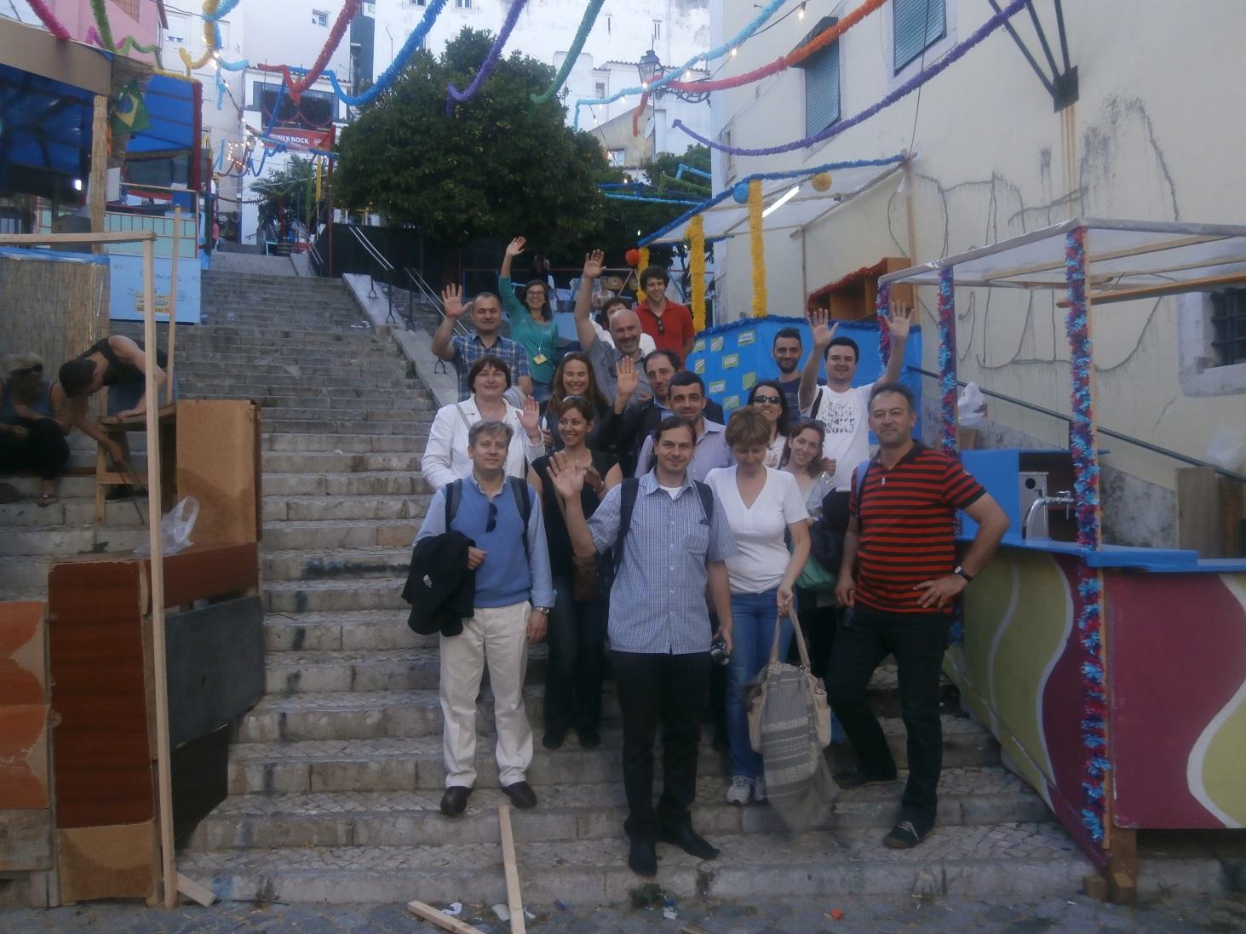
The numbers
Participants – 32 + 3
Participants from IAEA - 16
National Participants - 10
Lecturers - 6
Sessions - 20
Visit to the reactor
Coffee breaks - 10
Home made Cakes - 20
And much more…

Slide 3
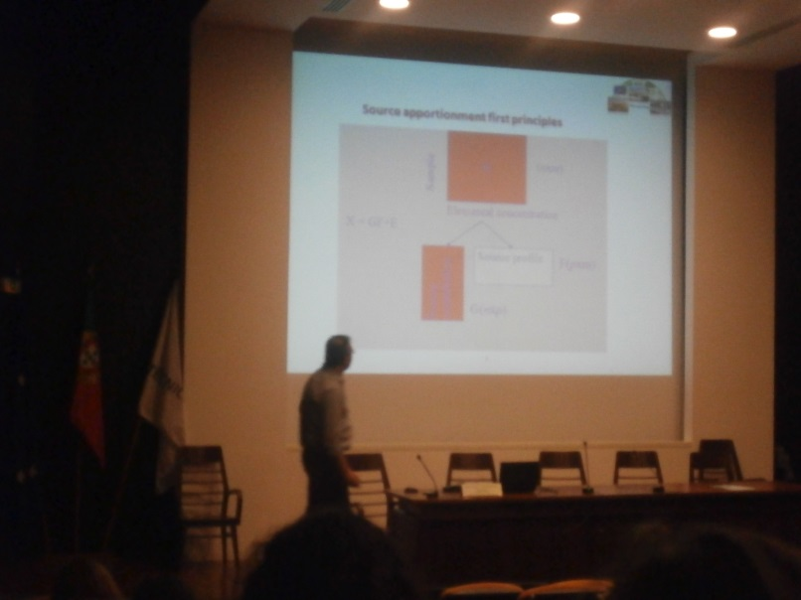
K. Eleftheriadis
Concepts about atmospheric particles - importance, size, chemical composition, sources, sinks and effects;
Sampling principles, methods and selection of sites;
Presentation of the ACEPT-AIR (Development of a Cost Efficient Policy Tool for reduction of Particulate Matter in Air) project which is an example how receptor models can be used for policy making;
Promote the discussion about the status of the sampling campaign that should be performed within RER 1013.

Slide 4
C. Martins
C. Martins represented the Portuguese Environmental Agency;
Legislation;
Responsibilities of the different players that are involved;
The Portuguese Air Quality Monitoring Network.

Slide 5
F. Ferreira
Air Quality levels in Portugal;
Main sources of pollutants in Portugal;
Portuguese Strategies on Air Pollution Control;
Lisbon low emission zone.

Slide 6
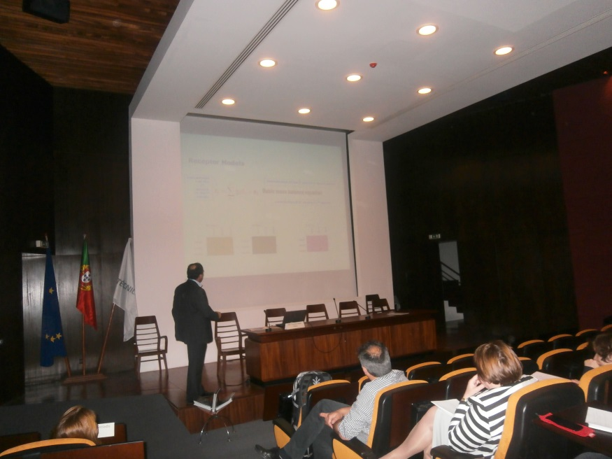
C. Belis
Receptor models fundamentals;
Source apportionment tools;
Advantages, complementarity of the different approaches;
Importance of the harmonization of the different tools;
Present the report “European Guide on Air Pollution Source Apportionment with Receptor Models” which objective is to promote the best available operating procedures and to harmonize their application across Europe;
Factor analysis specific procedures.

Slide 7
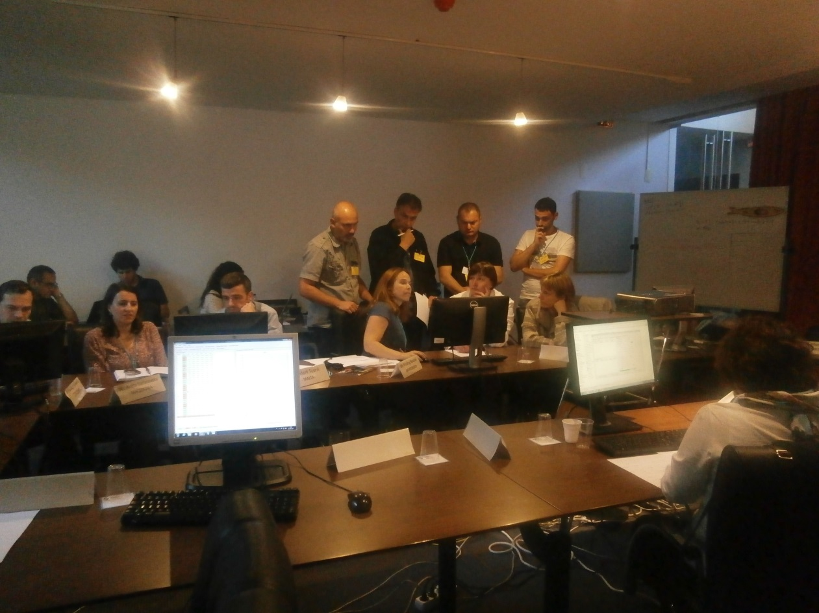
M. Almeida
Importance of quality control in the databases preparation;
Application of PMF to a case study;
Application of Open Air tools for air pollution data analysis.

Slide 8
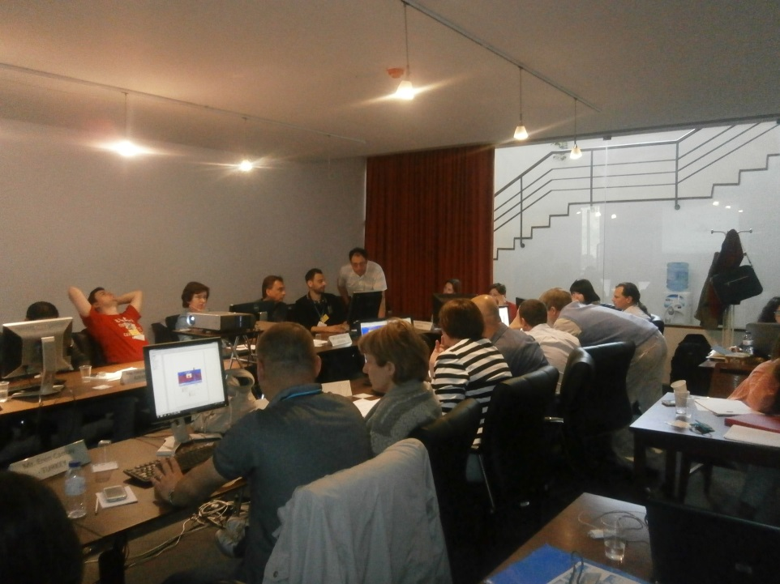
P. Salvador
Supplementary tools in receptor modeling based source apportionment;
Trajectory Statistical methods - Cluster Analysis; Residence Time Analysis; Concentration Fields Methodogy;
Advantages and disadvantages of these methodologies;
In the practical lectures Surfer program was introduced and Cluster Analysis and Residence Time Analysis was applied to a case study;

Slide 9
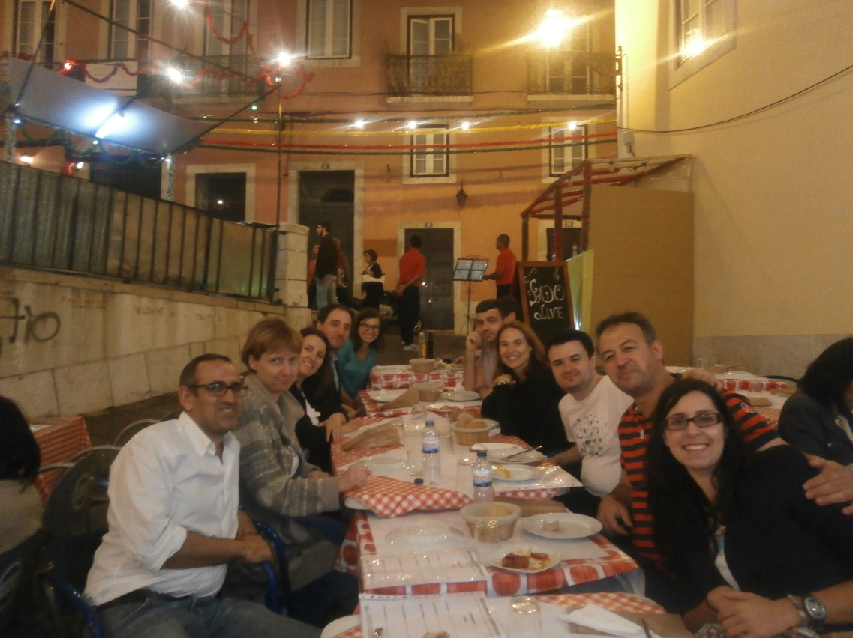
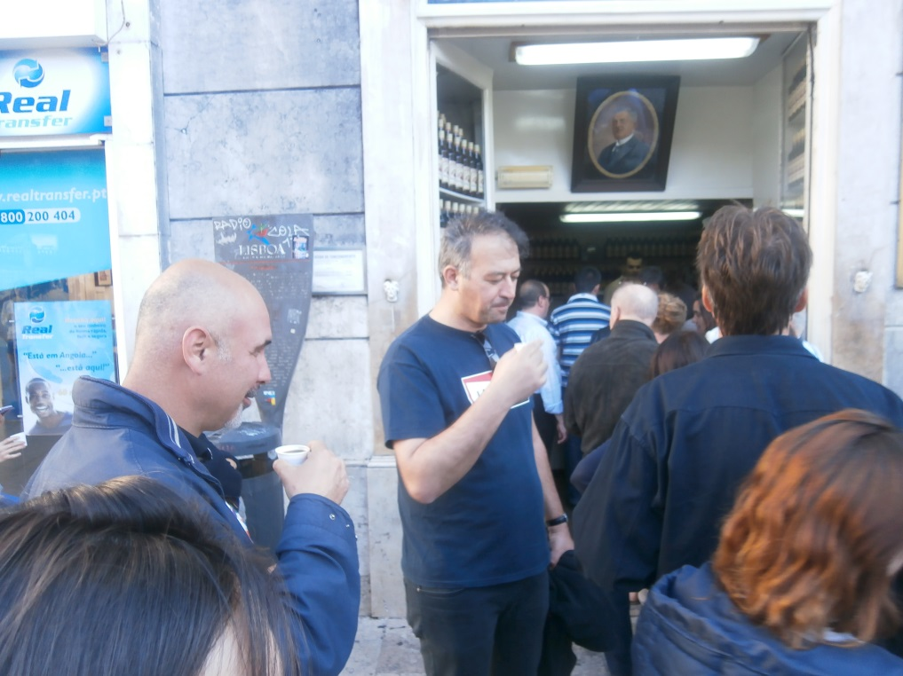
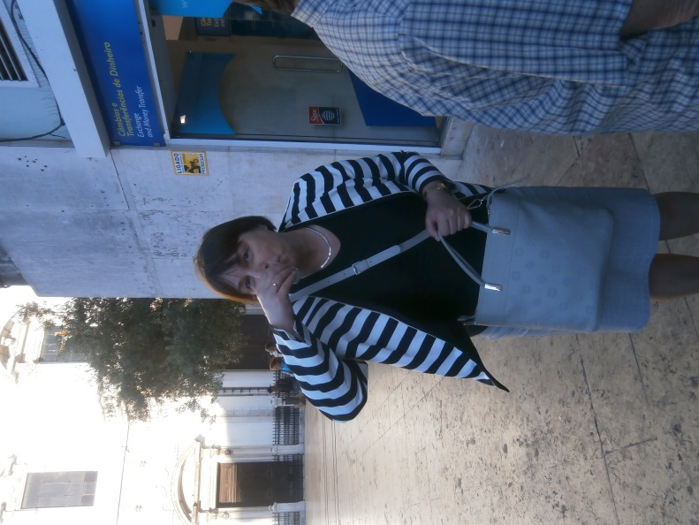
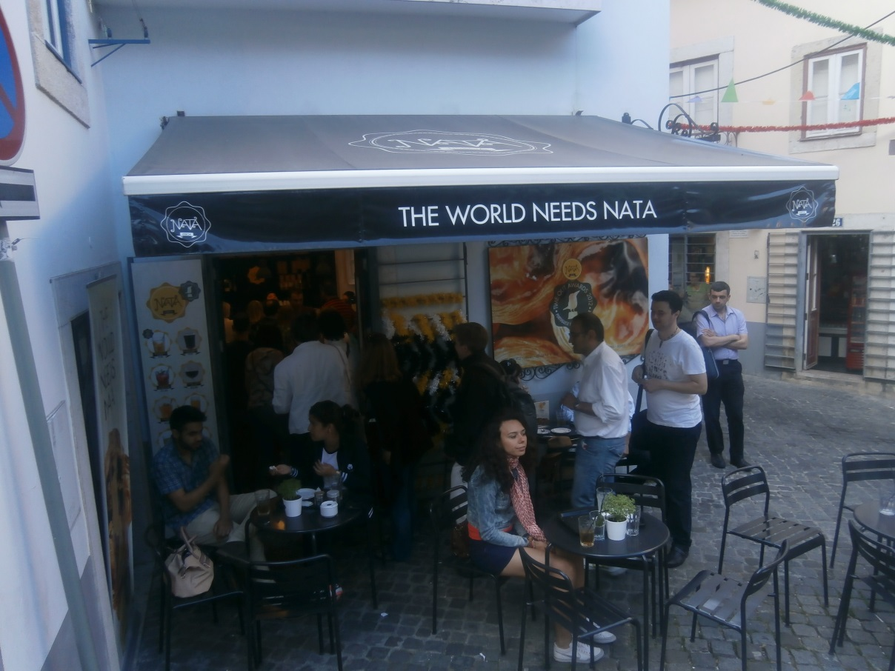
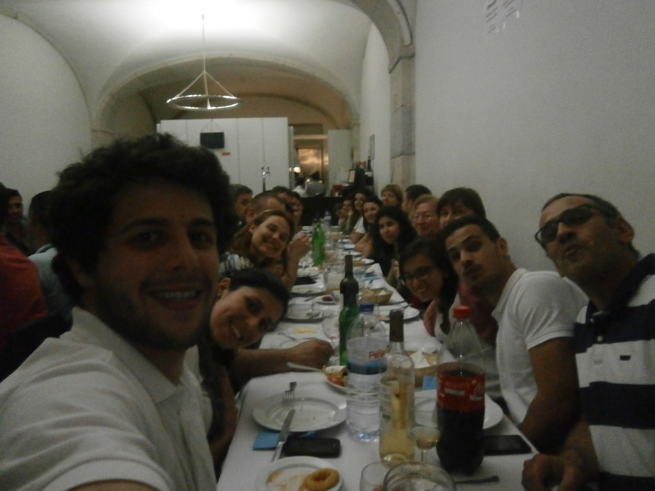
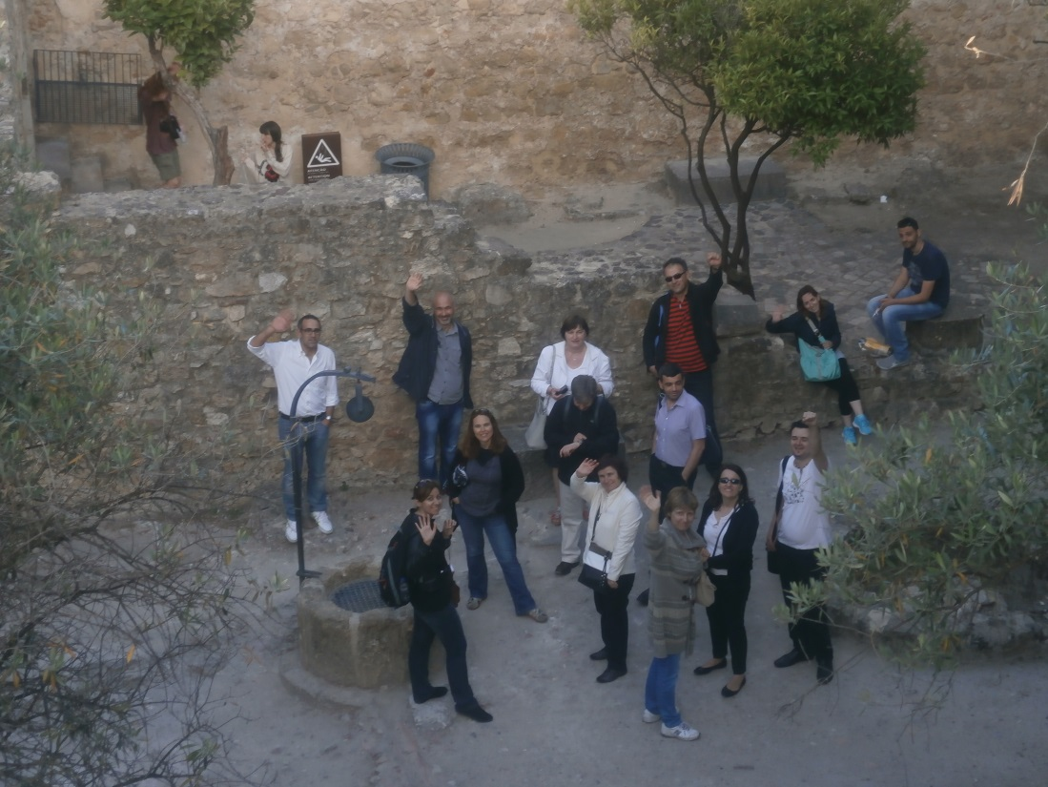
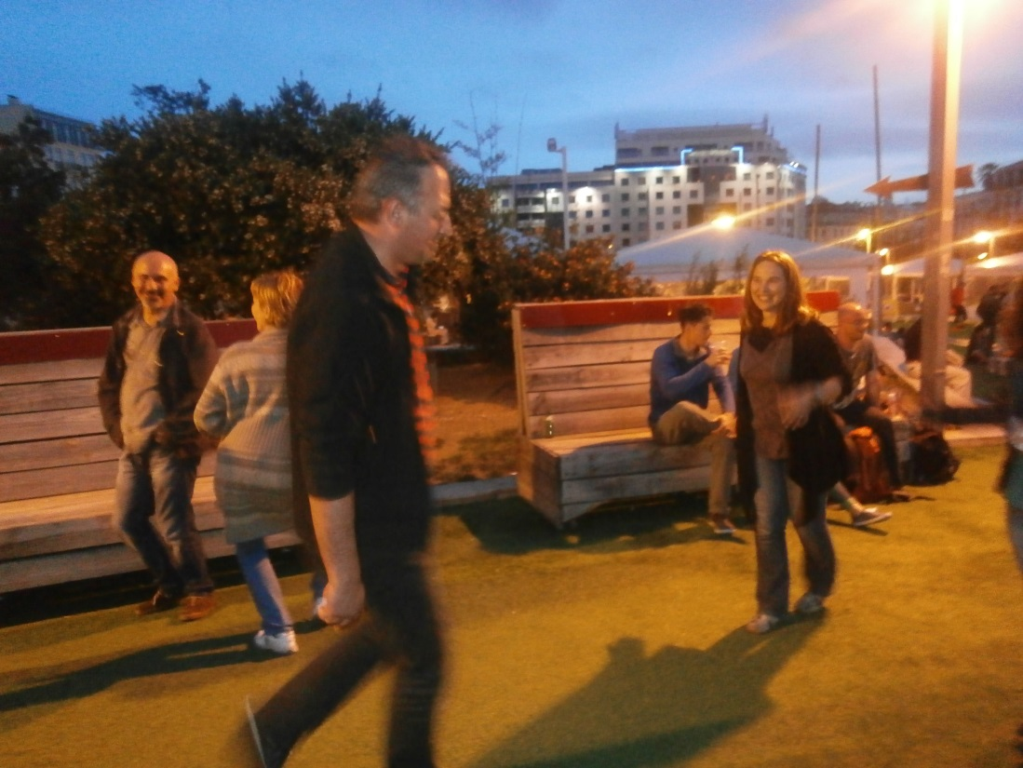

Slide 10


