Slide 1
Radioactive substances transport
Mestrado em Proteção e Segurança Radiológica
Fundamentos de Protecção e Segurança Radiológica
Safety depends primarily upon the package
Victoria Corregidor

Slide 2
The numbers…
Only 5% of radioactive transport is for nuclear spent fuel
20 million packages by road, sea and air per year
In 2009: 70.000 diagnosis scans using nuclear products
99Mo, world demand:
  In 2012: 23.000 TBq/year
  In 2016: 19.500 TBq/year
99Mo, half-live: 66h
7 . Class number: Radioactive Material

Slide 3
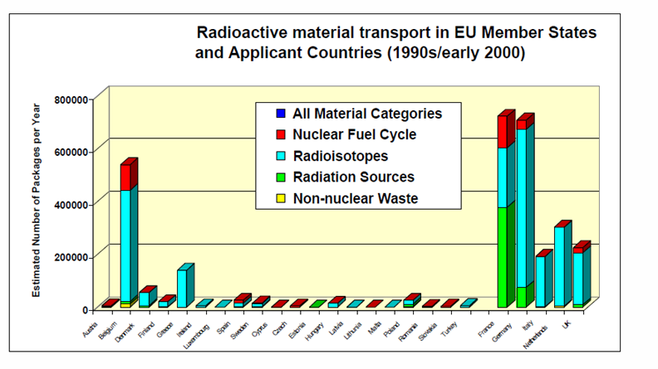
The numbers
Radioactive material transport in EU Member States and applicant countries (1990-2000)

Slide 4
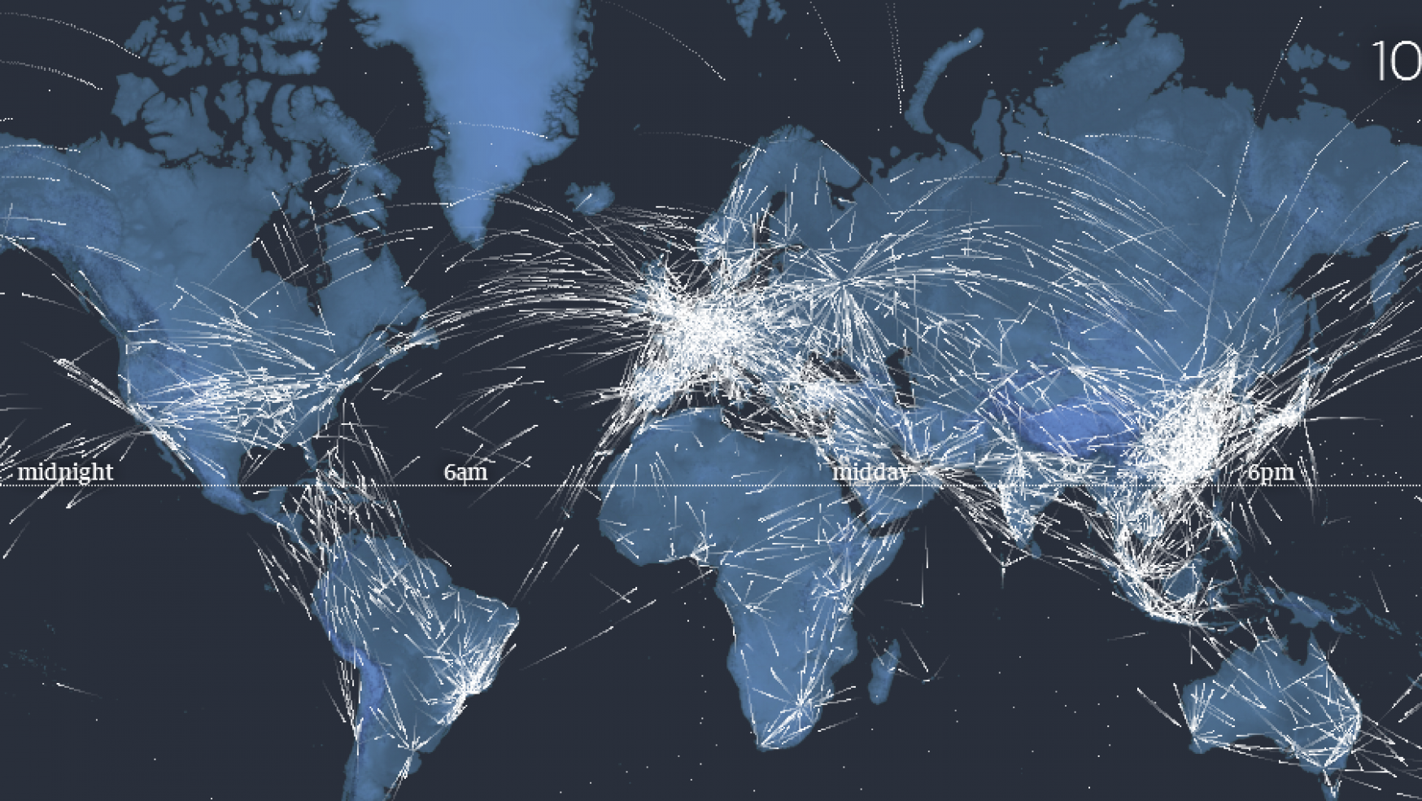
So…

Slide 5

So…
Radioactive materials usually are transported in public ships, airplanes and roads

Slide 6
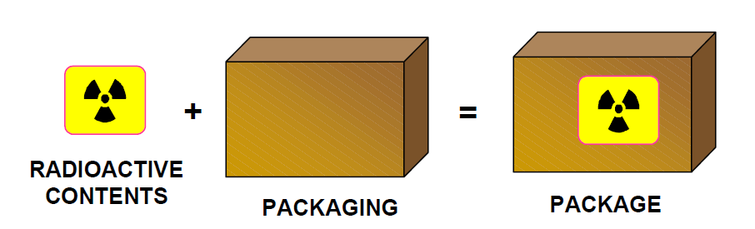
The image
The package, as indicated in Figure, is the packaging with its radioactive contents as presented for transport,
the packaging is the assembly of components necessary to enclose the radioactive contents completely.

Slide 7
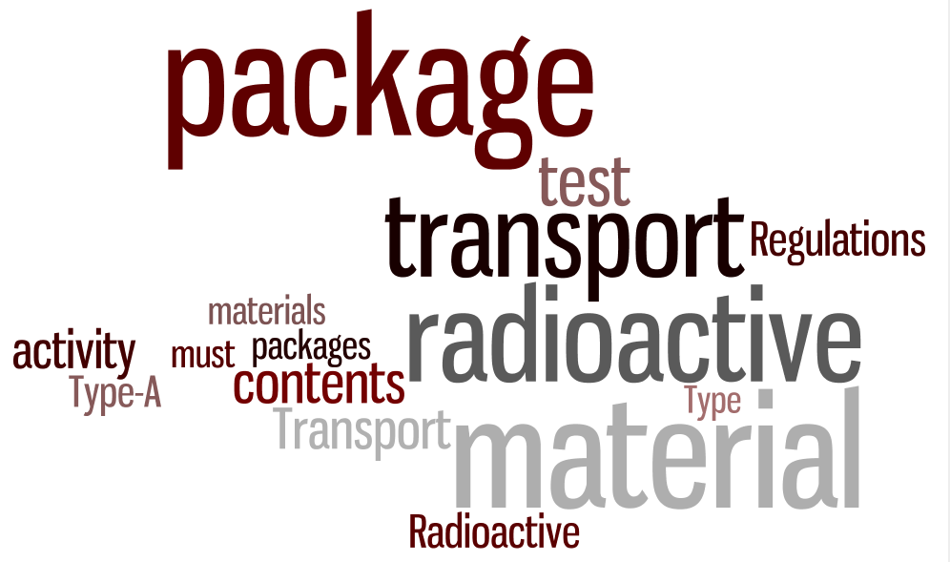
The words…

Slide 8
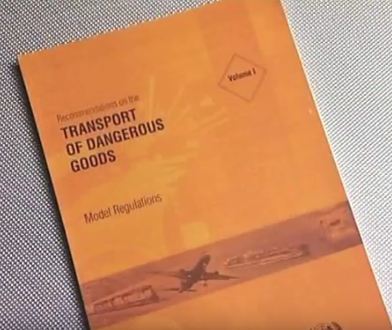
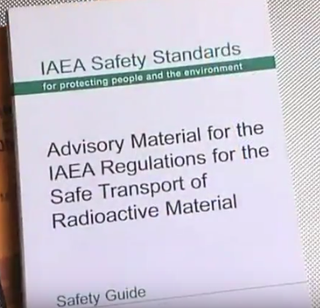
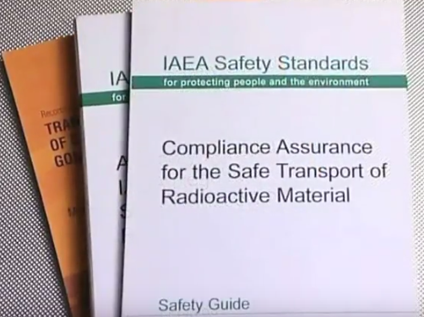
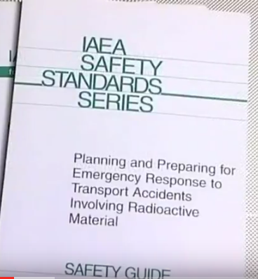
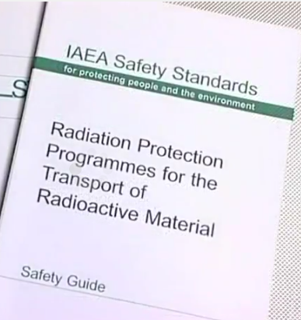
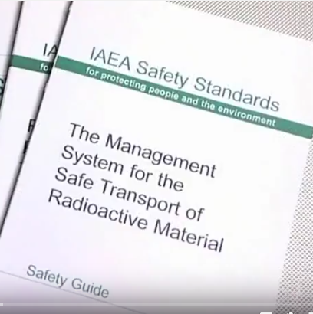
Regulations from the IAEA
At the IAEA there is a lot of documentation, REGULTATIONS that must be followed by all the members.

Slide 9
Packages
The package integrity is function of the hazard associated with the radioactive material:
the more hazardous the material, the harder /complex will be the packaging.
The size is not related with the hazardous of the material, some small packages may contain very large quantities of radioactivity.
According with the activity of the radioactive contents, there are five different types of packages:
  Excepted packages;
  Industrial package (Type IP-1, Type IP-2 and Type IP-3);
  Type A;
  Type B (Type B(U), TYPE B(M));
  Type C.
Activity, A

Slide 10
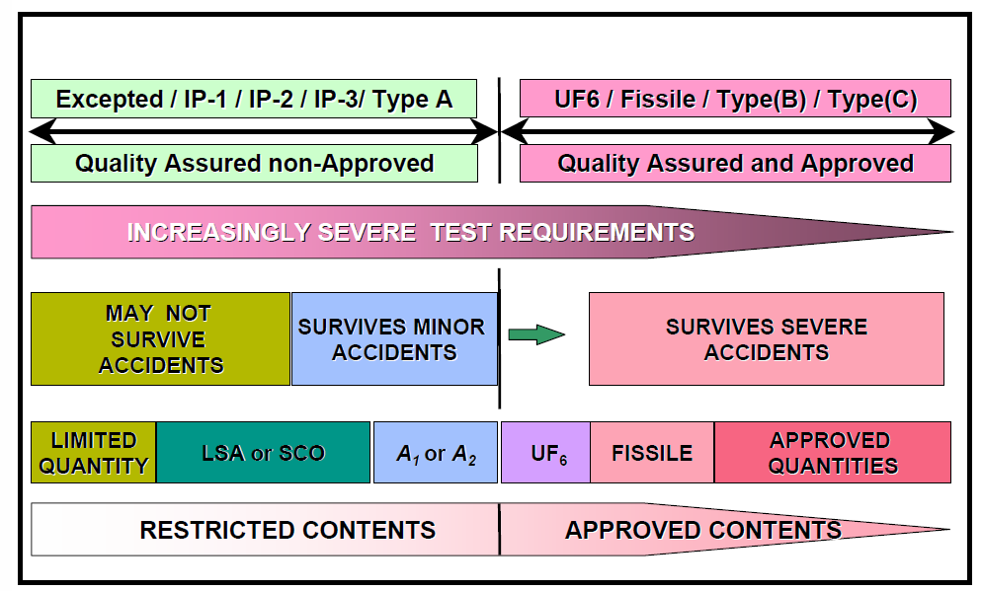
Packages design
Some materials and packages do not need a formal approval about the design (Excepted, Industrial and Type A packages) but others (Type B and Type C packages) need a formal approval

Slide 11
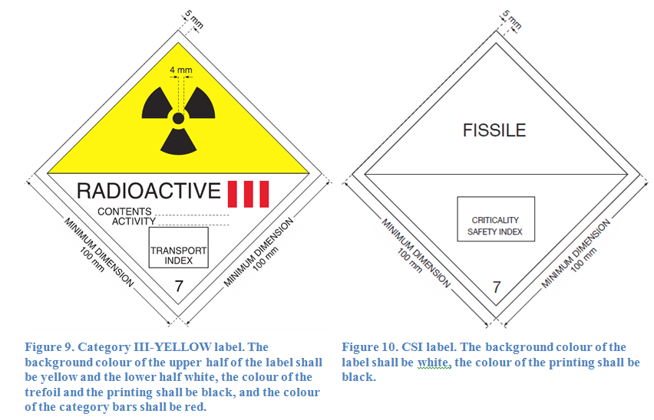
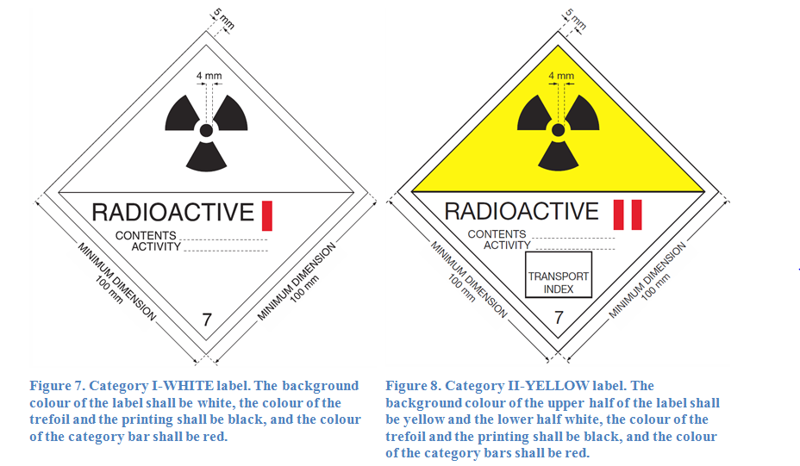
The labels
Ones the radioactive contents are protected/shielded/secured, they must be “announced”
Category Yellow II, 0.5 mSv/hr maximum at surface or has a TI lower than 1.
Category Yellow III 2 mSv/hr maximum at surface or has a TI lower than 10.

Slide 12
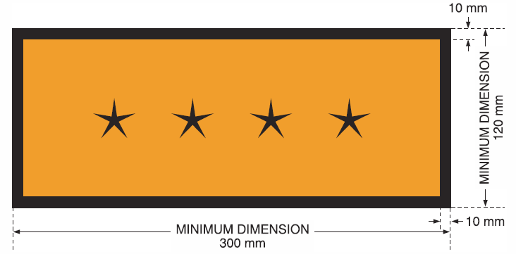
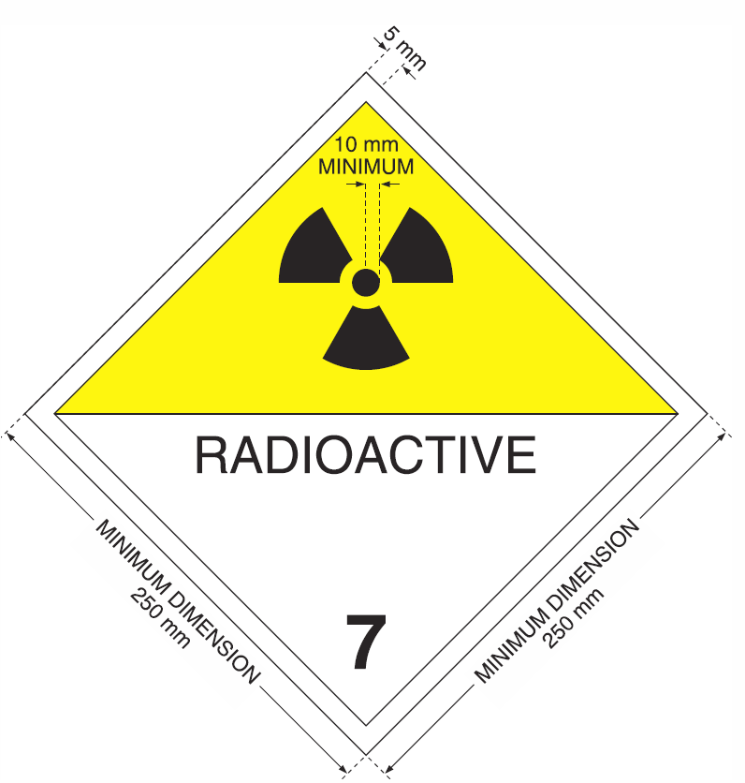
The placards
The placards inform:
  the public - the presence of hazards while they're driving or near large quantities of hazmat being transported.
  The emergency responders - may be the only way they know what materials are involved in the accident.
The symbol “****” denotes the space in which the appropriate UN number for radioactive material, as specified in Table 1 of SSR-6

Slide 13
In this work two different situation were considered:
60Co sources transport from Russia to the Technological Unit of Radiosterilization at Campus Tecnológico e Nuclear (CTN-IST):
  Curiosity,
  Opportunity (half life about 5 years).
Radionuclides and radiopharmaceutical products transport:
  Curiosity,
  The more transported,
  Higher probability to find them….

Slide 14
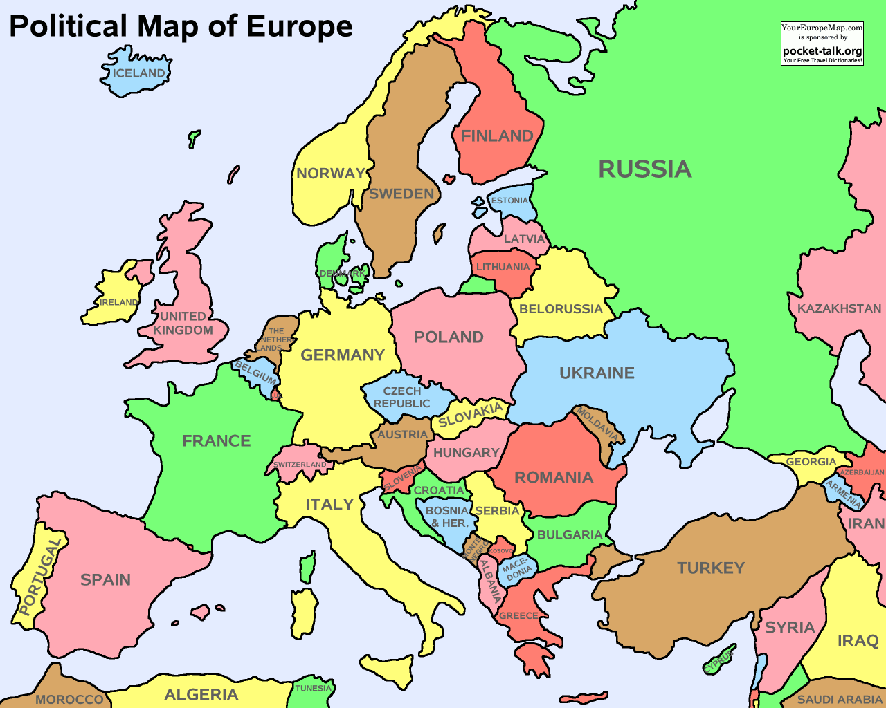
60Co sources transport
Russia – Belgium – Portugal
sea road
Many other countries involved
and National/International Institutions:
ROSATOM: Russian Federation national nuclear corporation
IAEA: International Atomic Energy Agency
FANC The Federal Agency for Nuclear Control, Belgium
DGS Direção-Geral da Saúde, Portugal
…
…

Slide 15
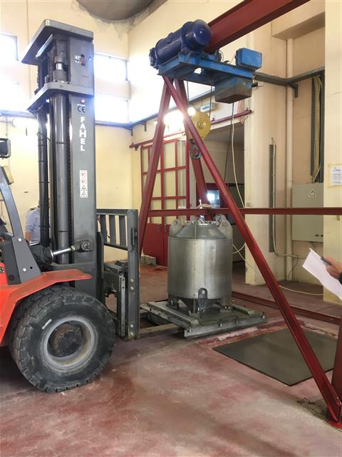
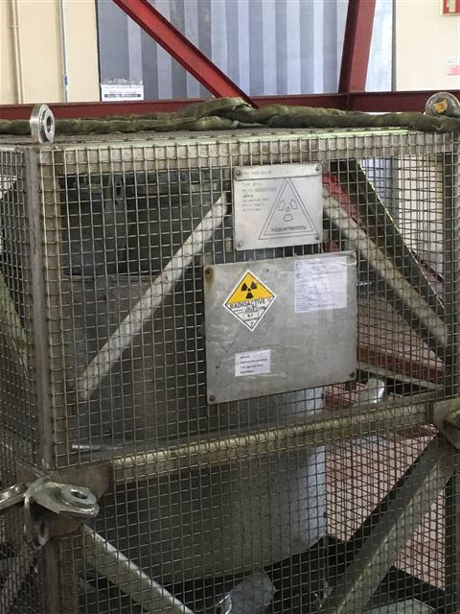
60Co package
A Type B(U) package:
The Regulations do not specify activity limits. The activity limits are generally established during design.
The design must be approved and tested.
P. Matos, UTR-IST

Slide 16
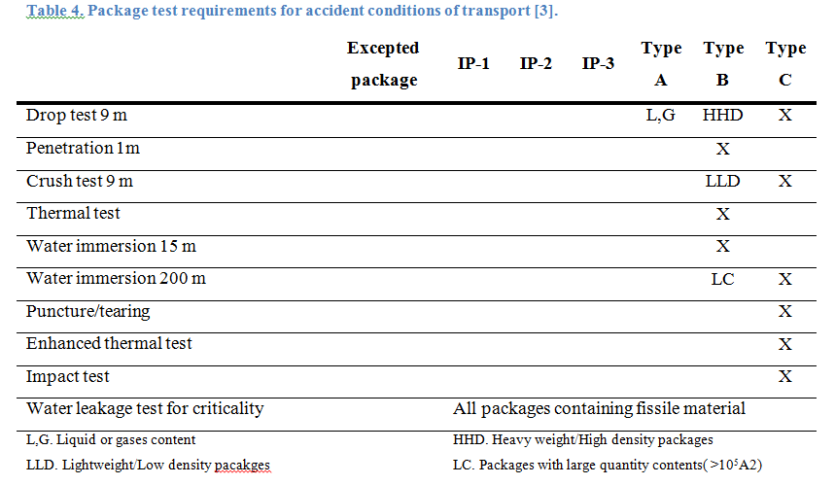
Packages tests

Slide 17
Packages tests

Slide 18
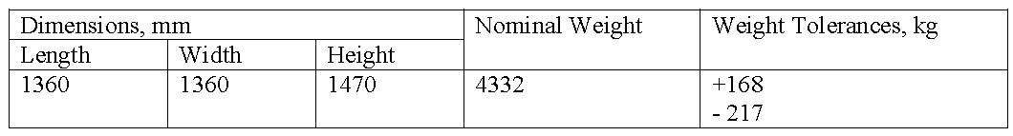
60Co package
P. Matos, UTR-IST

Slide 19
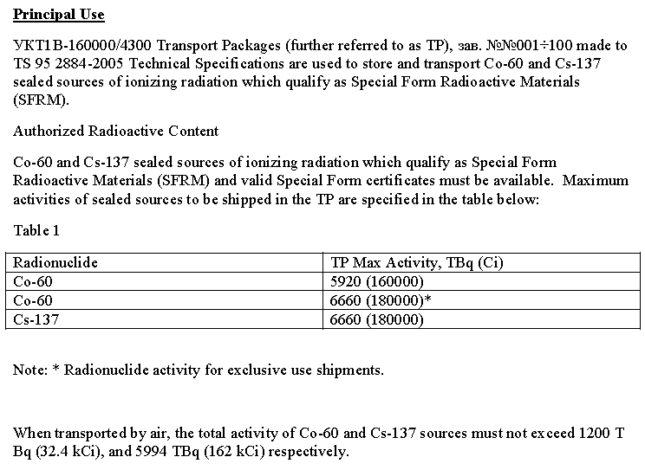
60Co package
P. Matos, UTR-IST

Slide 20
60Co package
P. Matos, UTR-IST

Slide 21
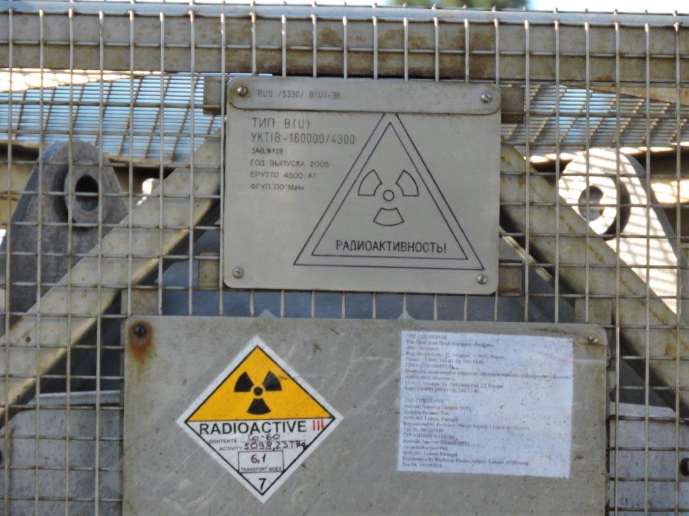
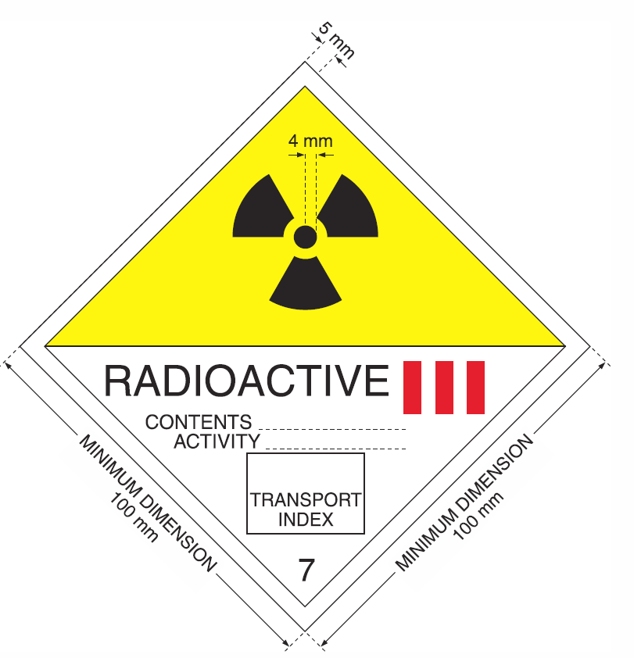
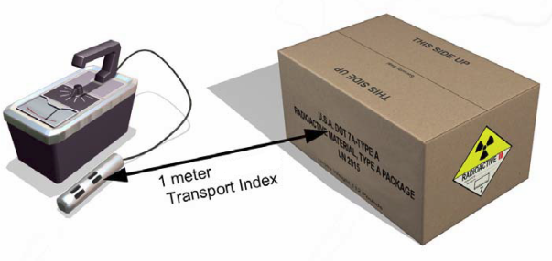
60Co package label
Contents: Co-60
Activity: 5098,23TBq
Transport Index: 6.1
UN Class number: 7
Transport Index, TI: provides control over radiation exposure and establish transport controls.
maximum radiation level measured (mSv/hr) at one meter from the package multiplied by 100.

Slide 22
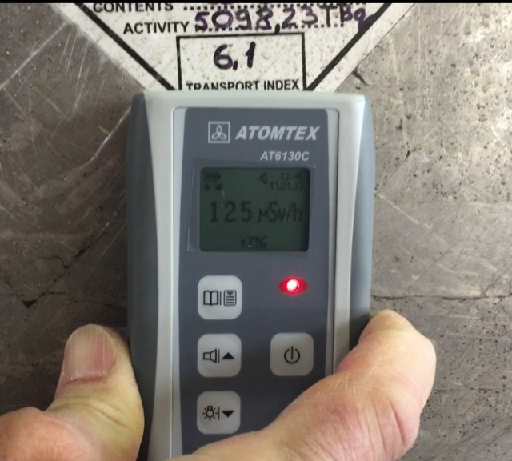
60Co package label
Contents: Co-60
Activity: 5098,23TBq
Transport Index: 6.1
UN Class number: 7
Shielding!!!!!!!!!!!
P. Matos, UTR-IST

Slide 23
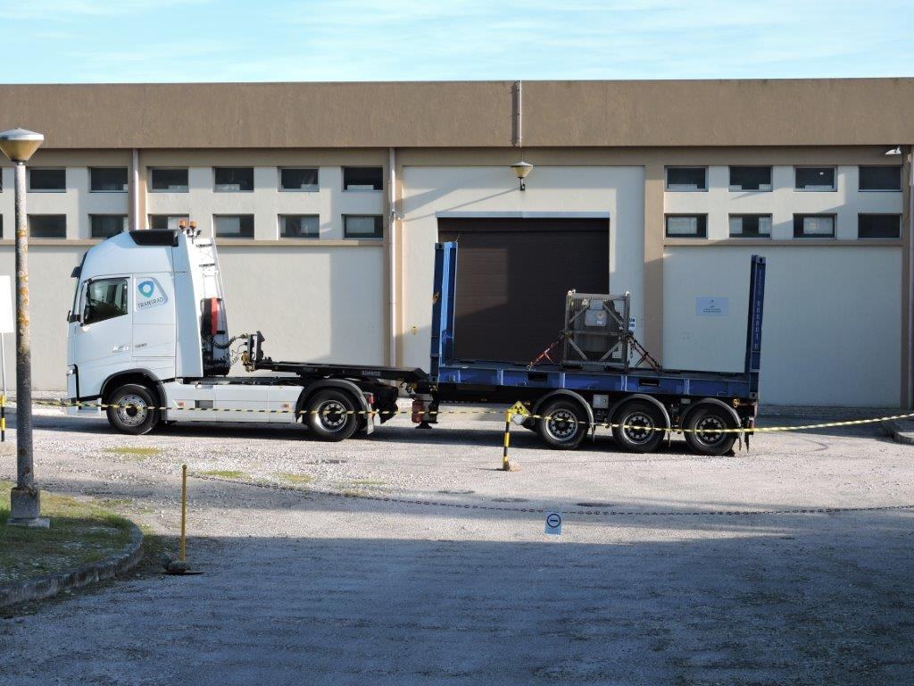
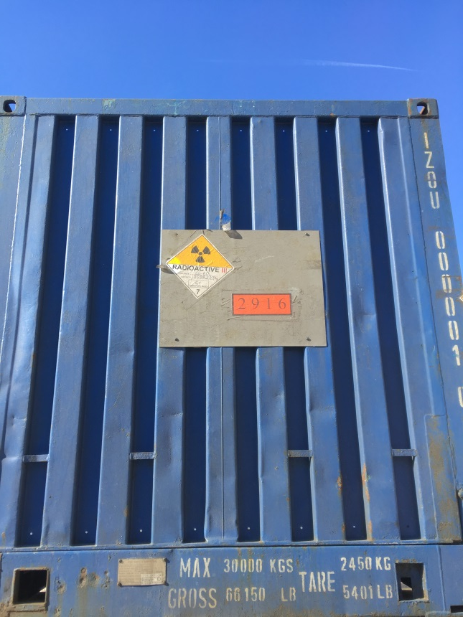
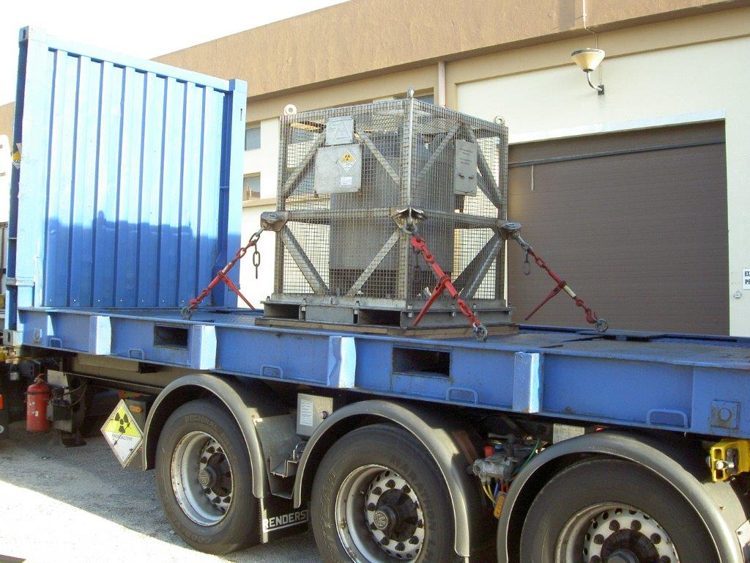
60Co package placards
The label, and the UN number
P. Matos, UTR-IST

Slide 24
Gamma radionuclides
From IAEA

Slide 25
Radionuclides and radiopharmaceutical products
Many of these radionuclides are produced in reactors or cyclotrons;
99mTc is by far the most used because its versatility and easy access;
In 2009 the number of diagnostic scans using 99mTc was about 70.000;
Within most industrialized countries, hundreds, and even thousands, of isotope packages are transported daily, the majority by road.
Reactor radioisotopes
 | Emission type | Used for | half-life
213-Bi | Alpha (8.4 MeV) | Cancer treatment | 46 min
131-Cs | Soft X-rays | Brachytherapy | 9.7 d
137-Cs |  | Blood sterilisation | 30 yr
125-I |  | cancer brachytherapy (prostate and brain) | 60 d
131-I | strong gamma emitter, but used for beta therapy | treating thyroid cancer and in imaging the thyroid; diagnosis of abnormal liver function, renal (kidney) blood flow and urinary tract obstruction | 8 d
99-Mo |  | Used as the 'parent' in a generator to produce 99mTc | 66 h
99m-Tc | Gamma | The most common radioisotope for diagnosis, accounting for over 80% of scans. | 6 h
32-P | Beta | treatment of polycythemia vera (excess red blood cells) | 14 d
153-Sm | Beta | relieve the pain of secondary cancers lodged in the bone. Also very effective for prostate and breast cancer | 47 h
89-Sr | Beta | Reduce the pain of prostate and bone cancer | 50 d
Cyclotron radioisotopes
11-C 13-N 15-O 18-F | positrons | used in PET for studying brain physiology and pathology | 20.4 s 9.9 s 2.1 s 109.7 m
64-Cu | Positrons | PET imaging of tumours, and also cancer therapy | 13 h
67-Cu | Beta | Therapy | 2.6 d
68-Ga | Positron | PET and PET-CT units. Derived from germanium-68 in a generator. | 68 min
123-I | gamma | diagnosis of thyroid function | 13h
124-I | positron | image the thyroid using PET | 4.2 d

Slide 26
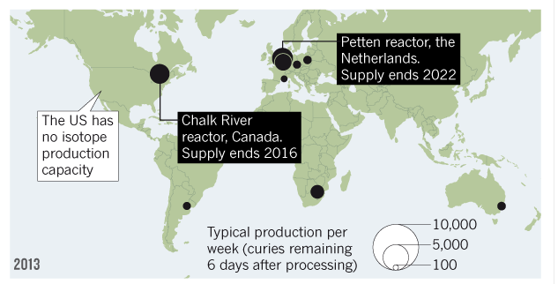
Radionuclides and radiopharmaceutical products
The main world radionuclides suppliers are Mallinckrodt Pharmaceuticals (Ireland), AECL/MDS Nordion (Canada), IRE (Europe), NTP (South Africa), Isotop-NIIAR (Russia) and ANSTO (Australia).

Slide 27
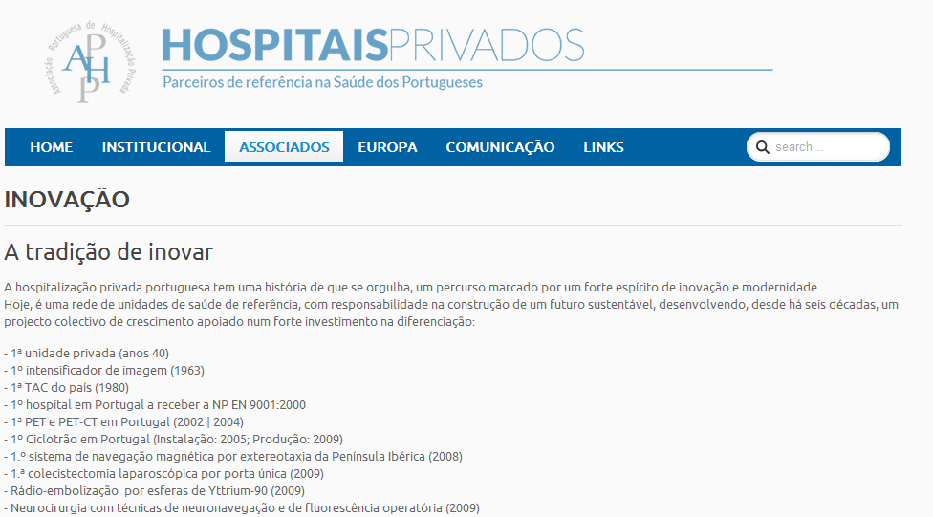
Radionuclides and radiopharmaceutical products
In Portugal, the data about the production of radioisotopes are scarce.
As far as my knowledge there are two cyclotrons which produces them, one is in Matosinhos (Porto) which is private and the other is in Coimbra, at ICNAS (Instituto de Ciências Nucleares Aplicadas à Saude). None of them offer any information in their websites.

Slide 28
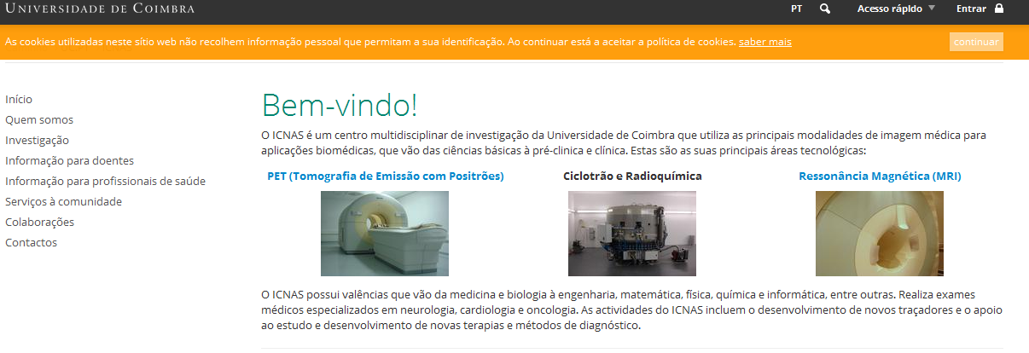
Radionuclides and radiopharmaceutical products
In Portugal, the data about the production of radioisotopes are scarce.
As far as my knowledge there are two cyclotrons which produces them, one is in Matosinhos (Porto) which is private and the other is in Coimbra, at ICNAS (Instituto de Ciências Nucleares Aplicadas à Saude). None of them offer any information in their websites.

Slide 29
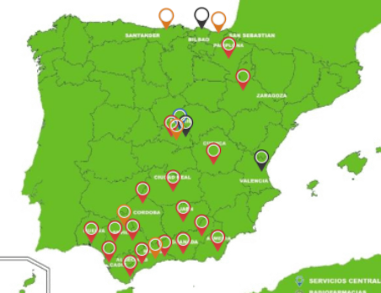
Radionuclides and radiopharmaceutical products
Radioisotopes as 18-F, 13-N, 11-C, 82-Rb and 68-Ga are commercialized as 18FDG, 18F-Colina, Na18F, 68Ga-DotaNOC e 18F-DOPA by ISODER SA [19], in partnership with ICNAS and IBA Molecular in Spain [20]. There are other European companies as ET Technological Institute [21], IRE [22] and MEDI-RADIOPHARMA [23] which provides also radiopharmaceutical products to Portugal.
IBA Molecular, 5 cyclotrons:
Madrid, Malaga, Santander,
San Sebastian, Sevilla.
???

Slide 30
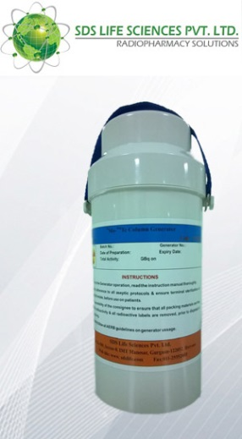
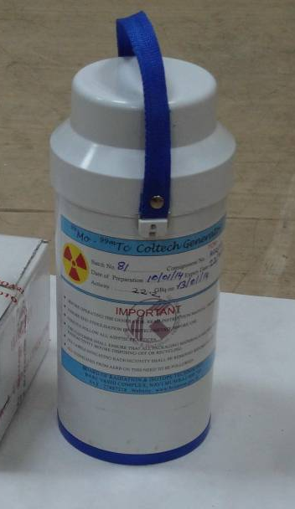
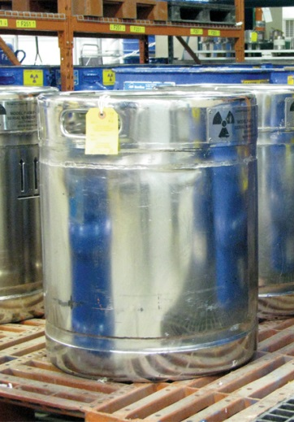
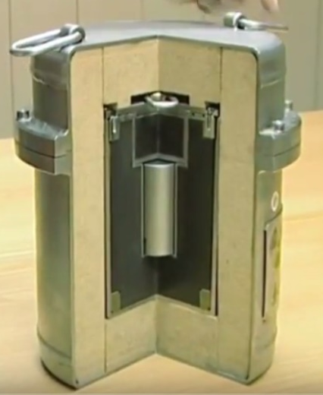
99Mo-99mTc Generators - packages
The activity to be transported will depend on the capacity of the generator.
Different packages Type A or Type B(U) can be used, according with the company.
Many hospitals receive a 99Mo-99mTc Generators each week.
99Mo
Type-A package | Type-A package | Type-B(U) | Type-B(U)

Slide 31
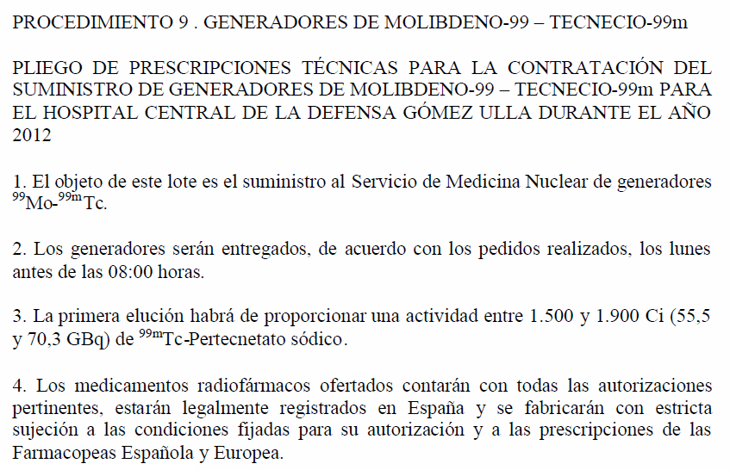
99Mo-99mTc Generators - packages

Slide 32
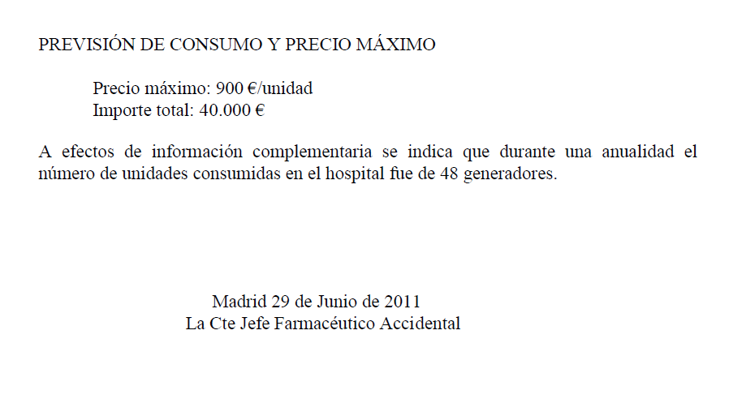
99Mo-99mTc Generators - packages

Slide 33
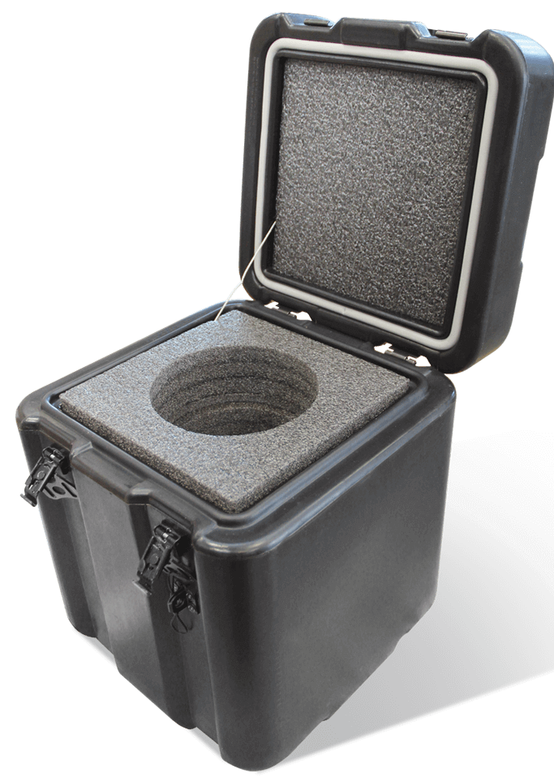
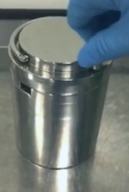
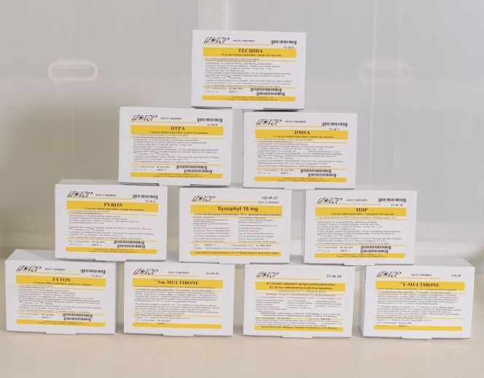
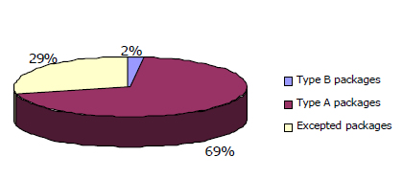
radiopharmaceuticals products
The activity to be transported will be about few kBq.
Usually, the packages used are Excepted package or Type A.
 | b
Type-A package | Type-A package | Excepted package
Distribution of packages by type in most countries from EU Member States.
packages Type A are the most frequently transported packages, followed by the Excepted packages

Slide 34
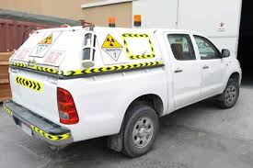
Police controls
The drivers are considered as occupationally exposed workers;
In the case of road vehicles, no persons other than the driver and assistants shall be permitted bearing category II-YELLOW or III-YELLOW labels.

Slide 35
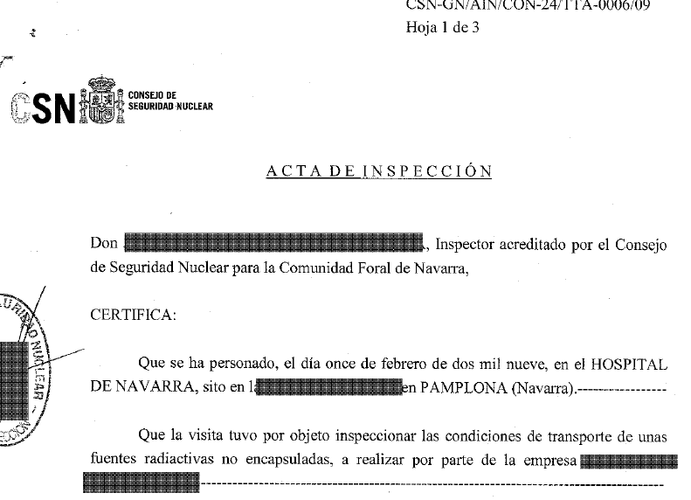
Police controls

Slide 36
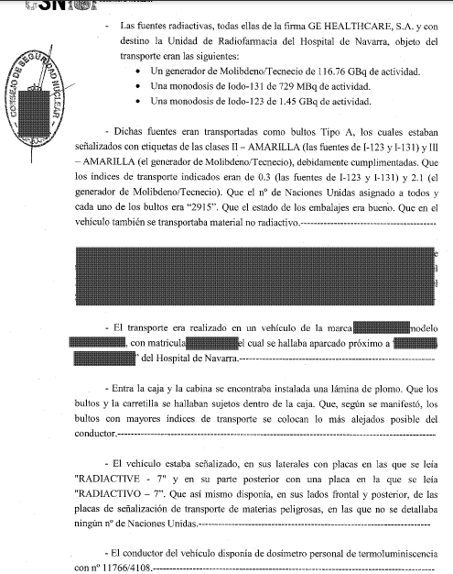
Police controls

Slide 37
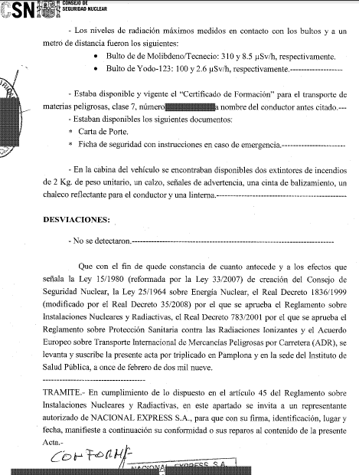
Police controls

Slide 38
Radionuclides and radiopharmaceutical products
From IAEA

Slide 39
Conclusions
Safety depends primarily upon the package.
The strict tests to which the packages are submitted and the obedience of Regulations ensure the protection to the man and the environment.
The Regulations are continuously upgraded from experience, advances in technology, changes in the modal transport environments, and socio-political forces.

Slide 40
Conclusions
Safety depends primarily upon the package.
The strict tests to which the packages are submitted and the obedience of Regulations ensure the protection to the man and the environment.
The Regulations are continuously upgraded from experience, advances in technology, changes in the modal transport environments, and socio-political forces.

Slide 41
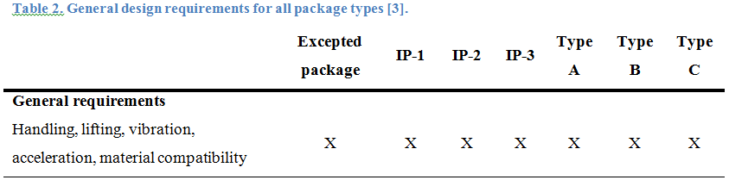
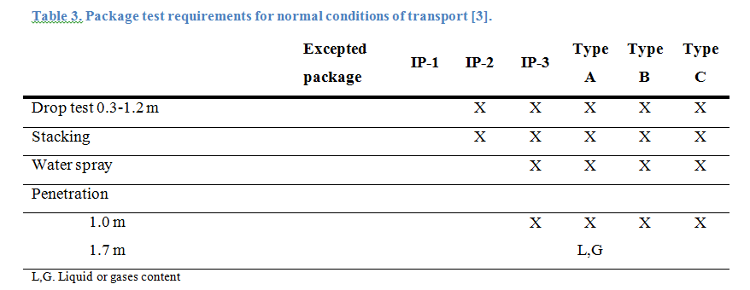
Packages tests

Slide 42
Packages tests

Slide 43
Packages tests

Slide 44
Packages tests

